Slide 1
M2

Slide 2

DIS
DISEASE
EASE
Means
Disturbed ease
What do we mean by disease ?

Slide 3
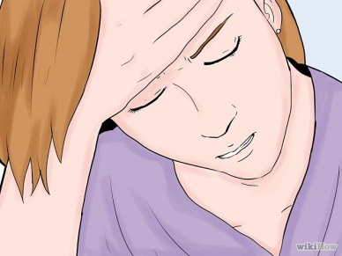

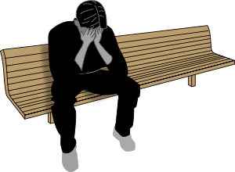
Disease :
Disease, in other words, literally means being uncomfortable.
We talk of disease when we can find a specific and particular cause for discomfort.
But it is possible to be in poor health without actually suffering from a particular disease.
Simply not being diseased is not the same as being healthy.
So, we can be in poor health without there being a simple cause in the form of an identifiable disease.
Let us now think a little more about diseases.
For e.g. Headache or fever

Slide 4
Disease and its causes :
How do we know that there
is a disease?

Slide 5
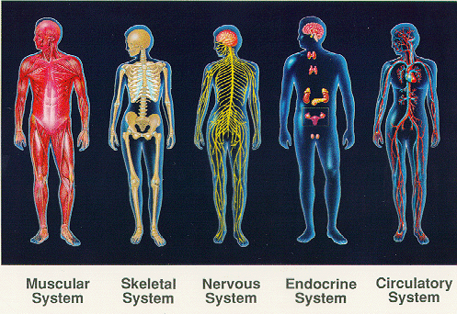

Disease and its causes :
Organ Systems
Tissues
Organs
There are many tissues in the body.
These tissues make up physiological systems or organ systems that carry out body functions.
Each of the organ systems has specific organs as its parts, and it has particular functions.

Slide 6
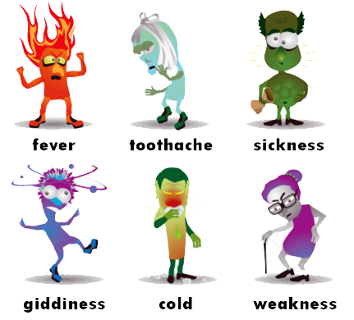
Disease and its causes :
When there is a disease, either the functioning or the appearance of one or more systems of the body will change for the worse.
These changes give rise to symptoms and signs of disease.

Slide 7
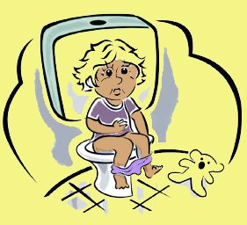
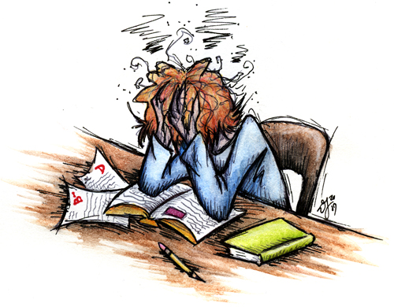
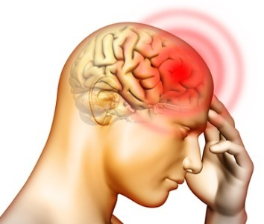
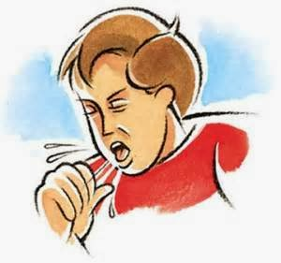
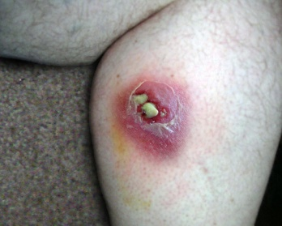
1.
Symptoms
Symptoms of disease are the things we feel as being ‘wrong’.
So we have a headache, we have cough, we have loose motions, we have a wound with pus; these are all symptoms.
These indicate that there may be a disease, but they don’t indicate what the disease is.
For example, a headache may mean just examination stress
or, very rarely, it may mean meningitis,
or any one of a dozen different diseases.
Infection of the covering of the brain

Slide 8
2.
Signs :
Signs of disease are what physicians will look for on the basis of the symptoms.
Signs will give a little more definite indication of the presence of a particular disease.
Physicians will also get laboratory tests done to pinpoint the disease further.

